Slide 1
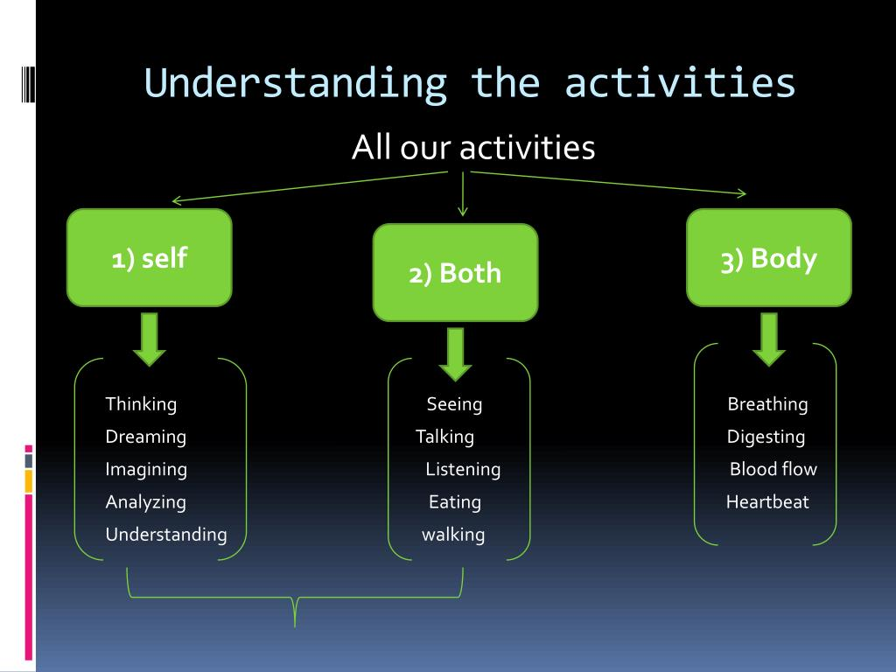
Universal Human Values
II B. Tech I Sem(R23)
ints
&
IV B.Tech I Sem(R21)
(Common for All Branches)
FAQ List

Slide 2

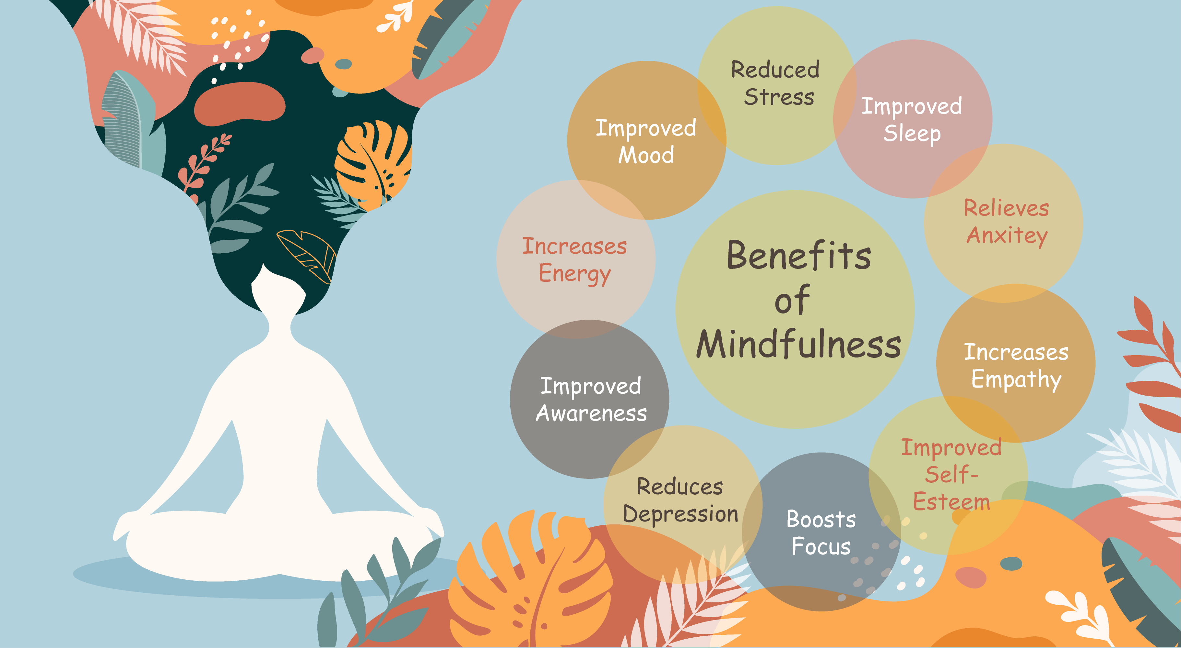
UNIT- II
Harmony in the Human Being

Slide 3
Contents
1. Understanding Human being as the Co-existence of the Self and Body
2. Response, Knowing & Assuming (Accepting)
3. Distinguishing between the needs of the self and body
4. The body as an instrument of the self: Basic human aspiration
5. Preconditioning, Sensation and Natural Acceptance
6. Source of Motivations for our Desires - Its Implications
7. Self Reflection- - happiness and physical facility
8.Harmony of the Self with the Body- Habits and Hobbies, SWOT Analysis (Activity), Sanyam and Health; correct appraisal of Physical needs, meaning of Prosperity in detail
9. Programme to ensure self-regulation and Health
10. Routine, Basic Principles Governing Health of Body
11. Indicators of Health of Body-E pidemiology- Definition of health, Social and Preventive Medicine, Personal hygiene and handling stress, WHO Guidelines
12. Practice Session-2

Slide 4
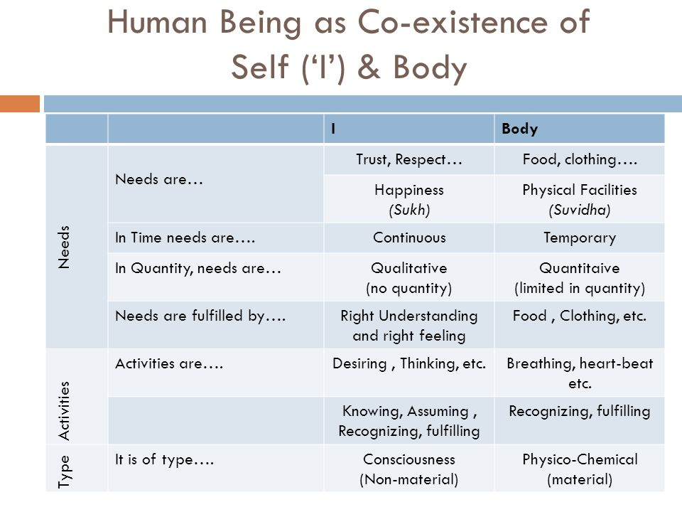
SESSION 13. Understanding Human being as the Co-existence of the Self and Body

Slide 5
Understanding Human being as the Co-existence of the Self and Body ..
A human being can be understood as the co-existence of two distinct entities: the Self, which is characterized by consciousness and the ability to feel and experience, and the Body, which is a material entity. The Self is the "I" that feels, thinks, and desires, while the Body is the physical form that interacts with the external world. These two components are interdependent, with the Self guiding the Body and the Body providing the physical basis for the Self's experiences. Here's a more detailed explanation 1. The Self (Consciousness):
a. The Self is the conscious entity within us, often referred to as "I" or "Jivana". b. It experiences feelings, thoughts, and desires. c. The Self's needs are qualitative, such as happiness, trust, respect, and fulfillment of relationships. d. The Self's activities include knowing, assuming, recognizing, and fulfilling. e. The Self is not limited by time or physical constraints.

Slide 6
Understanding Human being as the Co-existence of the Self and Body ..
2. The Body:
a. The Body is the material, physical form of a human being.
b. t interacts with the external world through senses and physical actions.
c. The Body's needs are quantitative and temporary, including physical facilities like food, clothing, and shelter.
d. The Body's activities are primarily recognizing and fulfilling needs.
e. The Body's needs are limited in quantity and time, unlike the Self's needs which are continuous.
3. Co-existence and Harmony:
a. The Self and the Body are not separate entities but rather exist in a state of co-existence and harmony.
b. The Self guides the Body's actions and activities.
c. The Body provides the physical platform for the Self's experiences and interactions with the world.
d. Harmony within the human being is achieved when both the Self and the Body are in balance, with their respective needs being fulfilled.
e. For example, the Self experiences happiness, while the Body requires physical facilities.

Slide 7
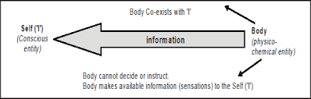
Understanding Human being as the Co-existence of the Self and Body ..
4. Key Differences:
a. Needs: The Self's needs are qualitative and continuous, while the Body's needs are quantitative and temporary.
b. Activities: The Self engages in activities like thinking, assuming, and recognizing, while the Body focuses on physical actions and fulfilling needs.
c. Experiencing: The Self experiences feelings like happiness, sorrow, and pain, while the Body experiences physical sensations.
References:
Textbook:1 Page No(59-74) R R Gaur, R Asthana, G P Bagaria, A Foundation Course in Human Values and Professional Ethics

Slide 8
SESSION 14. Response, Knowing & Assuming (Accepting)
Knowing, Assuming, Recognizing & Fulfilling in I and Recognizing & Fulfilling in Body
In the previous section, we saw that the activities in ‘I’ and those in the Body can be clearly distinguished. We will now look at the activities in ‘I’ and Body from a different perspective.
Activities of Recognizing and Fulfilling In the Body
We saw that breathing, heart-beats, digestion, etc. were activities in the body. The activities of the Body can also be understood as ‘recognition and fulfillment’. In fact, the mutual
In human values, "knowing" refers to understanding reality as it is, while "assuming" or "accepting" involves forming beliefs or expectations based on that understanding. The interaction between these two shapes our responses and conduct, with assumptions based on knowledge leading to definite and harmonious responses, while assumptions without knowledge can lead to problems.

Slide 9
Response, Knowing & Assuming (Accepting)…
Here's a breakdown:
1. Knowing:
Definition:
Knowing is the process of understanding reality as it is, without bias or pre-conceived notions. It's about perceiving things as they truly are.
Example:
Recognizing that a sharp needle can pierce the skin while a blunt one cannot is an example of knowing, according to the provided text.
2. Assuming/Accepting:
Definition:
Assuming or accepting is the process of forming beliefs, expectations, or interpretations based on what we know or think we know. This can be influenced by our past experiences, education, and cultural background.
Example:
Assuming that a person holding a syringe intends to harm you, even if they are a doctor, is an example of assuming, according to the text.
References:
Textbook:1 Page No(73-77) R R Gaur, R Asthana, G P Bagaria, A Foundation Course in Human Values and Professional Ethics

Slide 10
SESSION 15. Distinguishing between the needs of the self and body
We will now take up some exercises to distinguish the needs of the Self (‘I’) and the Body
Firstly, fill in the answers in the table below. Do not see the right answers until you have completed yours!
2. Next, make your own list of needs, and find out which ones are related to the Self (‘I’) and which ones are related to the Body.
3. One thing to be noted here is that we are making a list of our wants here, which may or may not be a need (we have assumed it to be a need). That’s why the two columns read as ‘Related to Body?’, and not of the body; and ‘Related to ‘I’? , and not of the ‘I’.
Needs of the "I" (Self):
Qualitative Needs:
These are not material or physical but relate to the self's well-being and fulfillment.
Examples:
Happiness, trust, respect, love, and a sense of belonging.
Nature:
These needs are continuous, meaning they are ongoing and not limited to a specific time or situation.
Fulfillment:
Right understanding, right feelings, and harmonious relationships with others contribute to fulfilling the needs of the "I".

Slide 11
Distinguishing between the needs of the self and body…
Needs of the Body:
Quantitative Needs:
These are related to the physical body and its requirements for survival and well-being.
Examples:
Food, clothing, shelter, healthcare, and physical facilities for comfortable living.
Nature:
These needs are temporary and need to be fulfilled through material things and physical actions.
Fulfillment:
These needs are met through physical resources, technologies, and appropriate care for the body.
Distinguishing Between the Needs:
1. The "I" (Self) is the Seer, Doer, and Enjoyer: It is the conscious entity that desires, thinks, and feels.
2. The Body is an Instrument: The body is used by the "I" to interact with the world and fulfill its needs.
3. Continuous vs. Temporary: The "I" needs continuous happiness, while the body has temporary needs.
4. Fulfillment through Different Means: The "I" is fulfilled through understanding and feelings, while the body is fulfilled through physical resources.

Slide 12
Distinguishing between the needs of the self and body…
Harmony and Fulfillment:
1. Understanding the difference is essential for harmony: When the "I" and the body's needs are understood and addressed appropriately, it leads to a state of harmony and fulfillment.
2. Balancing both sets of needs: It is important to work towards fulfilling both the needs of the "I" and the body for a balanced and fulfilling life.
3. Right Understanding and Right Feeling: These are crucial for understanding and fulfilling the needs of the "I".
References:
Textbook:1 Page No(78-83) R R Gaur, R Asthana, G P Bagaria, A Foundation Course in Human Values and Professional Ethics

Slide 13
SESSION 16. The body as an instrument of the self: Basic human aspiration
In human values, the body is understood as an instrument of the self, not the self itself. The self, or "I," is the conscious entity that experiences, desires, and makes decisions, while the body is the tool it uses to interact with the physical world and express itself. This perspective emphasizes that the body's needs (like food and shelter) are distinct from the self's needs (like happiness and fulfillment).
Here's a more detailed explanation:
1. The Self (I) as the Decision-Maker:
The self is the core of human existence, the center of consciousness and decision-making.
It experiences, desires, and chooses how to act.
It is not limited to the physical body and its functions.
2. The Body as an Instrument:
The body is a physical entity, a tool that the self uses to interact with the world.
The self directs the body's actions, like eating, walking, or speaking.
The body has its own needs, primarily for physical facilities like food, shelter, and clothing.
3. The Importance of Harmony:
Maintaining harmony between the self and the body is crucial for human well-being.
This harmony involves understanding the different needs of the self and the body and fulfilling them appropriately.
For example, the self might desire to learn a new skill, which requires the body to engage in practice and effort.

Slide 14
The body as an instrument of the self: Basic human aspiration …
4. Examples:
The self decides to eat, and the body then performs the actions of chewing and swallowing.
The self wants to express love, and the body might use gestures and words to convey that emotion.
The self desires to feel respected, and the body might be dressed in a way that conveys that feeling, but the respect itself is a need of the self, not the body.
5. Implications for Human Values:
This understanding emphasizes that happiness and fulfillment come from within the self, not from external factors like material possessions or physical appearances.
It highlights the importance of self-awareness, self-regulation, and living in accordance with one's values.
It encourages a holistic view of the human being, recognizing the interconnectedness of the self and the body.
References:
Textbook:1 Page No(173-176) R R Gaur, R Asthana, G P Bagaria, A Foundation Course in Human Values and Professional Ethics

Slide 15
SESSION 17. Preconditioning, Sensation and Natural Acceptance
Preconditioning, Sensation, and Natural Acceptance are key concepts in understanding human values and harmony, particularly within the framework of Universal Human Values (UHV). Preconditioning refers to assumptions and beliefs formed without proper understanding, often based on external influences, and may not lead to genuine happiness. Sensation, derived from our senses, provides temporary experiences of pleasure or pain, but not sustained happiness. Natural acceptance, on the other hand, is the inherent understanding within each individual of what is truly valuable and conducive to harmony, leading to continuous and fulfilling happiness.
Elaboration:
1. Preconditioning:
Preconditioning is like accepting something as true or valuable without questioning or verifying it.
These assumptions are often formed due to external influences like societal norms, media, or peer pressure.
Preconditioning can lead to a state of confusion and contradiction because it's not based on one's own understanding.
For example, one might pre-condition themselves to believe that happiness comes from buying the latest gadgets, even if it doesn't align with their deeper values.

Slide 16
Preconditioning, Sensation and Natural Acceptance…
2. Sensation:
Sensation refers to the experiences we have through our five senses: sight, sound, smell, taste, and touch.
These sensations can be pleasurable or unpleasant, but they are temporary and often fleeting.
For instance, enjoying a delicious meal provides temporary happiness, but it doesn't guarantee lasting fulfillment.
The problem with relying solely on sensations for happiness is that it can lead to a cycle of seeking ever-stronger sensations to feel good, which can be unsustainable.
3. Natural Acceptance:
Natural acceptance is our innate ability to understand what is truly valuable and conducive to our well-being.
It's a sense of harmony and fulfillment that comes from living in accordance with our true nature.
Natural acceptance is universal and unchanging, unlike preconditioning and sensations which can be easily influenced.
Examples of natural acceptance include the desire for relationships based on trust and respect, or the need for harmony within ourselves and with nature.
Living in accordance with natural acceptance leads to genuine and lasting happiness.

Slide 17
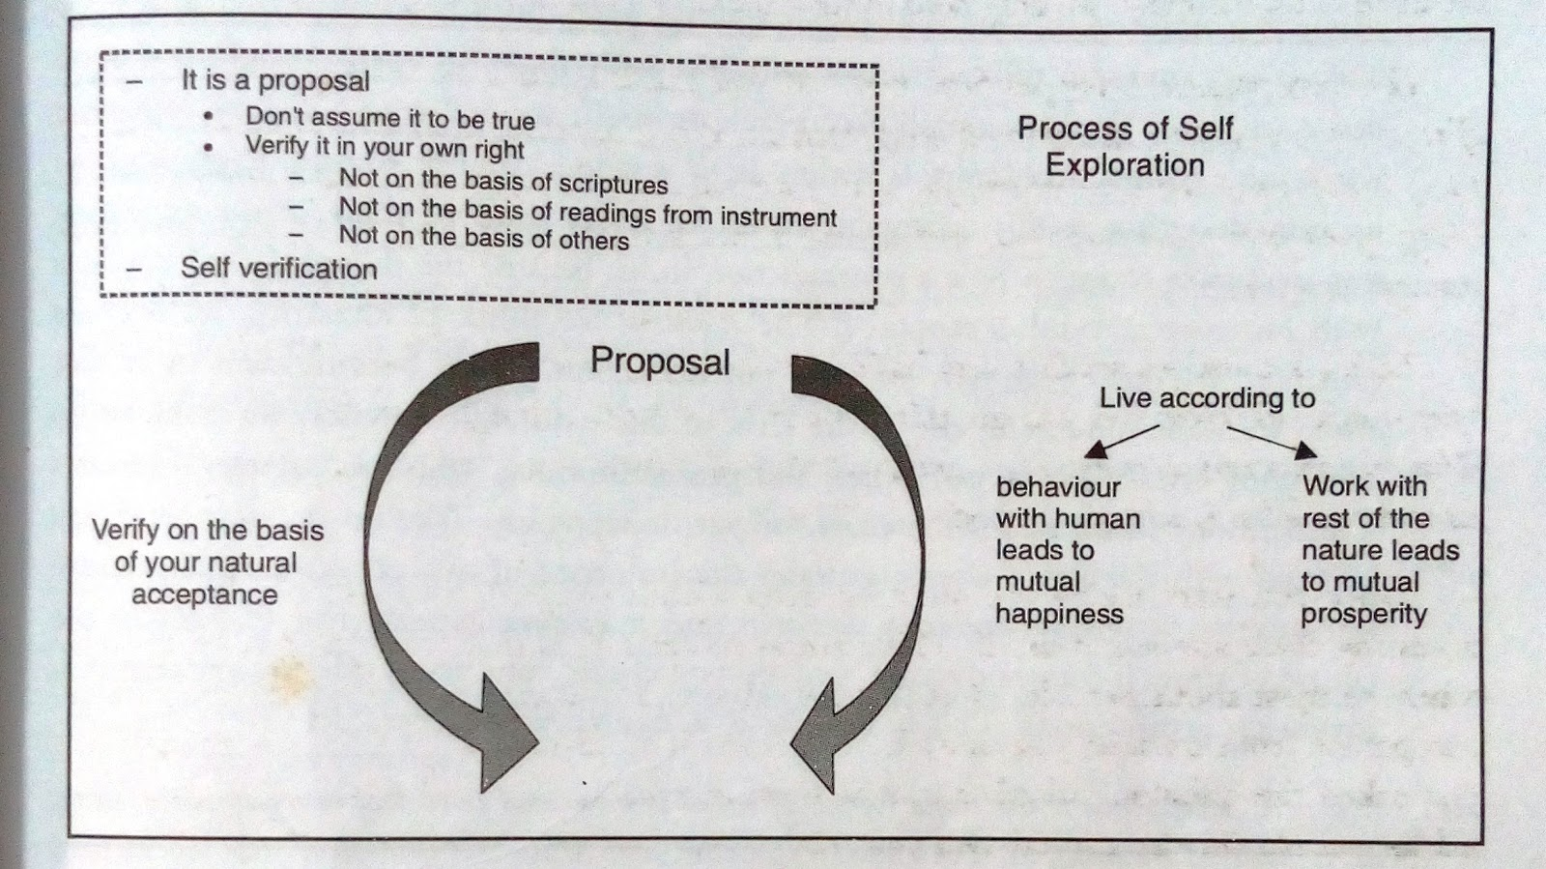
Preconditioning, Sensation and Natural Acceptance
References:
Textbook:1 Page No(19-22) R R Gaur, R Asthana, G P Bagaria, A Foundation Course in Human Values and Professional Ethics

Slide 18
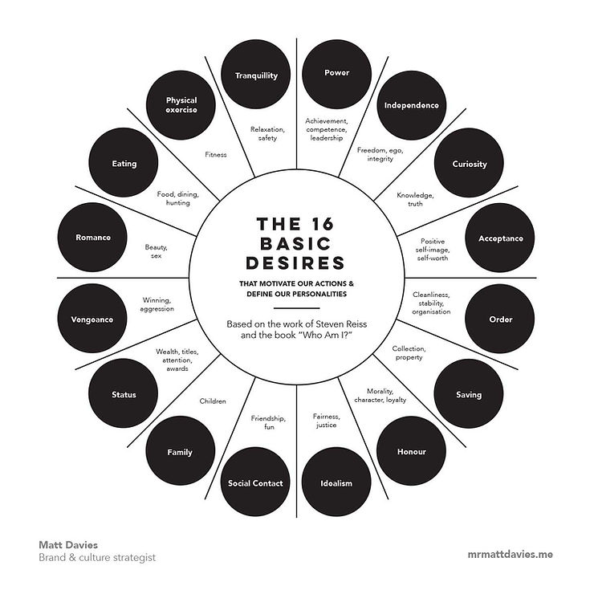
SESSION 18. Source of Motivations for our Desires - Its Implications

Slide 19
Source of Motivations for our Desires - Its Implications…
The source of our desires and motivations can be understood through various lenses, including biological needs, psychological factors, and social influences. Understanding these sources has implications for personal development, behavior modification, and even societal structures.
Sources of Motivation:
Biological Needs:
These are fundamental drives for survival and well-being, such as hunger, thirst, and the need for shelter.
Psychological Needs:
These include the need for autonomy, competence, and relatedness, as outlined by Self-Determination Theory, as well as the need for self-esteem and a positive self-concept.
Social Influences:
Our desires and motivations can be shaped by cultural norms, social expectations, and the desire for social acceptance and belonging.
Extrinsic Motivation:
This arises from external factors like rewards, punishments, or recognition from others.
Intrinsic Motivation:
This stems from internal factors, like enjoyment, curiosity, or a sense of accomplishment.
Rational and Irrational Motivation:
Rational motivation is based on logical reasoning, while irrational motivation may be driven by emotions, biases, or unconscious desires.

Slide 20
Source of Motivations for our Desires - Its Implications…
Implications:
Self-Awareness:
Understanding the sources of our desires can lead to greater self-awareness and the ability to make more conscious choices.
Goal Setting:
Identifying the motivations behind our goals can help us set more realistic and achievable targets.
Behavior Change:
Recognizing the drivers of our behavior can help us modify unhealthy habits or develop new, positive behaviors.
Relationship Dynamics:
Understanding the motivations of others can improve communication and empathy in interpersonal relationships.
Societal Structures:
By understanding the sources of motivation, we can design social systems that promote well-being and positive social outcomes.
Examples:
A person might be motivated to exercise by the desire to lose weight (extrinsic) or the enjoyment of physical activity (intrinsic).
A student might be motivated to study for an exam by the fear of failing (extrinsic) or the desire to learn and understand the material (intrinsic).
A person might be motivated to volunteer by the desire to help others (altruistic) or the desire for social recognition (egoistic).
References:
Textbook:1 Page No(95-115) R R Gaur, R Asthana, G P Bagaria, A Foundation Course in Human Values and Professional Ethics

Slide 21
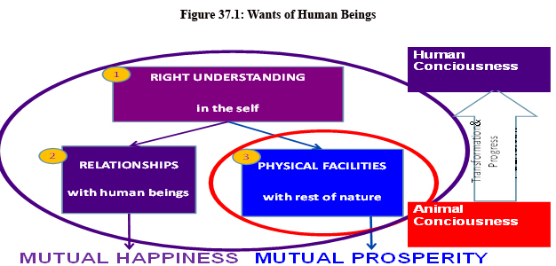
SESSION 19. Self Reflection- - happiness and physical facility
Self-reflection on happiness and physical facilities reveals that while physical facilities fulfill bodily needs, happiness is a qualitative, continuous need of the "Self" (or "I") and is achieved through right understanding and right feeling, not solely through material possessions. Understanding the difference between these needs is crucial for a fulfilling life.
Here's a more detailed breakdown:
1. Needs of the Self (I):
Happiness:
This is a qualitative, continuous need, not a quantitative one. It's not something you can measure in units like "half a kilogram of happiness".
Other Self-Needs:
These include trust, respect, love, and joy, which are also qualitative and continuous.
Fulfillment:
These needs are fulfilled through right understanding and right feelings, not through physical objects or possessions.

Slide 22
Self Reflection- - happiness and physical facility…
2. Needs of the Body:
Physical Facilities: These are quantitative needs, like food, clothing, shelter, etc., that are necessary for the body's sustenance and well-being.
Fulfillment: These needs are fulfilled through material things and physical actions.
3. The Interplay:
No Replacement:
Physical facilities cannot replace the need for happiness, and vice versa. You can't buy happiness with material possessions, nor can you survive on happiness alone.
Mutual Support:
While they are distinct, physical facilities can support the fulfillment of the Self's needs by providing a conducive environment for right understanding and living.
Example:
If you are respected and feel happy, but don't have food, your physical needs are not met, and vice versa.
References:
Textbook:1 Page No(63-69) R R Gaur, R Asthana, G P Bagaria, A Foundation Course in Human Values and Professional Ethics

Slide 23
SESSION 20. Harmony of the Self with the Body- Habits and Hobbies, SWOT Analysis (Activity), Sanyam and Health; correct appraisal of Physical needs, meaning of Prosperity in detail
Harmony of the self with the body involves understanding the interconnectedness and mutual responsibility between one's consciousness ("I") and the physical body. This includes recognizing the body as an instrument for the self and taking responsibility for its well-being through nurturing, protection, and proper utilization. Habits and hobbies play a crucial role in this harmony, and a SWOT analysis can help in optimizing them for physical and mental well-being. Sanyam (self-regulation) is essential for health, ensuring the body functions optimally and in harmony with the self. Prosperity, in this context, involves having a correct understanding of physical needs and ensuring their fulfillment in excess of what is required.
Habits and Hobbies
Habits:
Definition: Actions repeated regularly, often unconsciously, shaping daily routines.
Examples: Brushing teeth, exercising, drinking coffee, checking social media.
Purpose: Provide structure, consistency, and can contribute to personal goals.
Consciousness: Often performed without much conscious thought.
Hobbies:
Definition: Activities pursued for pleasure, enjoyment, and relaxation.
Examples: Painting, playing sports, reading, gardening, playing musical instruments.
Purpose: Offer personal enrichment, stress relief, and opportunities for creative expression.
Consciousness: Involve conscious choice and deliberate engagement.

Slide 24
Harmony of the Self with the Body- Habits and Hobbies, SWOT Analysis (Activity), Sanyam and Health; correct appraisal of Physical needs, meaning of Prosperity in detail…
SWOT Analysis (Activity)
A SWOT analysis, which stands for Strengths, Weaknesses, Opportunities, and Threats, is a strategic planning tool that can be applied to various aspects of life, including the exploration of universal human values. By examining personal values through a SWOT lens, individuals can better understand their core beliefs, identify areas for growth, and align their actions with their values.
Applying SWOT Analysis to Universal Human Values:
1. Strengths
2. Weaknesses
3. Opportunities
4. Threats
Benefits of a Values-Based SWOT Analysis:
Self-Awareness:
Gaining a deeper understanding of your core values and how they influence your behavior.
Personal Growth:
Identifying areas for improvement and setting goals for aligning your actions with your values.
Enhanced Decision-Making:
Making choices that are consistent with your values and contribute to a more meaningful life.
Stronger Relationships:
Fostering trust and connection with others by demonstrating your values.
Purposeful Living:
Living a life that is aligned with your core beliefs and contributes to a more positive world.

Slide 25
Harmony of the Self with the Body- Habits and Hobbies, SWOT Analysis (Activity), Sanyam and Health; correct appraisal of Physical needs, meaning of Prosperity in detail…
Sanyam and Health
In the context of universal human values, Sanyam (self-control) and Swasthya (health) are interconnected concepts. Sanyam refers to the ability to control one's mind, senses, and desires, while Swasthya encompasses physical and mental well-being, where all parts of the body function harmoniously.
Sanyam (Self-Control)
Involves regulating one's thoughts, emotions, and actions.
It is the feeling of responsibility in the "I" (self) to nurture, protect, and properly utilize the body, recognizing the body as an instrument.
Obstacles to Sanyam include a lack of understanding, emotional outbursts, impulsiveness, and a lack of self-belief.
Swasthya (Health)
Encompasses both physical and mental well-being, where all parts of the body function optimally and are in harmony with the self.
Includes physical health (proper functioning of all body parts), social health (harmonious relationships), and mental health (peace of mind).
Achieving Swasthya requires proper nutrition, digestion, rest, exercise, and the right utilization of the body.
References:
Textbook:1 Page No(117-125) R R Gaur, R Asthana, G P Bagaria, A Foundation Course in Human Values and Professional Ethics

Slide 26
SESSION 21. Programme to ensure self-regulation and Health
A program ensuring self-regulation and health within the framework of universal human values emphasizes a holistic approach to well-being, focusing on harmony between the body and the self through conscious lifestyle choices and self-awareness. This involves understanding and acting upon one's responsibility towards their body, ensuring its proper functioning and balance.
Key aspects of the program include
Healthy Lifestyle:
Maintaining a balanced diet, adequate hydration, regular physical activity, and proper sleep are crucial for physical well-being.
Self-Regulation:
This involves regulating one's actions and behaviors to align with natural acceptance and promote harmony within oneself and with others.
Self-Awareness:
Understanding one's body, its needs, and its limitations is essential for making informed choices that support overall health.
Harmony:
The program aims to achieve harmony within the self, between the self and the body, and between the self and others, fostering a sense of well-being and happiness.
Responsible Care:
Recognizing the body as an instrument for fulfilling one's purpose and taking responsibility for its nurturing, protection, and proper utilization.

Slide 27
Programme to ensure self-regulation and Health…
Practical components of the program may include
Engaging in constructive work:
Participating in activities that are beneficial to oneself and society, promoting physical and mental well-being.
Practicing postures and regulated breathing:
Techniques like yoga and pranayama can help regulate bodily functions and promote inner balance.
Seeking appropriate treatment:
Addressing any physical imbalances through medicine or traditional treatments when necessary, while minimizing dependence on external aids.
Developing self-discipline and emotional regulation:
Learning to manage triggers, stay calm in challenging situations, and make conscious choices that align with one's values.
References:
Textbook:1 Page No(166-168) R R Gaur, R Asthana, G P Bagaria, A Foundation Course in Human Values and Professional Ethics

Slide 28
SESSION: 22 Routine, Basic Principles Governing Health of Body
Maintaining physical health is a universal human value, encompassing routine and basic principles that promote well-being. These principles include a balanced diet, regular physical activity, adequate sleep, and stress management. Furthermore, universal human values like respect for self and others, honesty, and compassion play a crucial role in fostering a healthy lifestyle and a supportive environment for physical and mental well-being.
1. Universal Human Values and Health
Love, Truth, Right Conduct, Peace, and Non-violence
Respect for Self and Others
Honesty and Trust
Compassion and Empathy
2. Basic Principles for Physical Health
Balanced Diet
Regular Physical Activity
Adequate Sleep
Stress Management
3. Routine and Consistency
Establishing a Routine
Self-Discipline
Regular Health Checkups
References:
Textbook:1 Page No(243-244) R R Gaur, R Asthana, G P Bagaria, A Foundation Course in Human Values and Professional Ethics

Slide 29
SESSION :23 Indicators of Health of Body-Epidemiology- Definition of health, Social and Preventive Medicine, Personal hygiene and handling stress, WHO Guidelines
Indicators of Health of Body-Epidemiology
In the context of public health, health indicators are measurable factors that reflect the health of a population and are used to assess health status, monitor health trends, and evaluate health interventions.
Types of Health Indicators:
Mortality Indicators:
These indicators measure deaths within a population and include measures like life expectancy, infant mortality rate, and maternal mortality ratio.
Morbidity Indicators:
These indicators reflect the prevalence and incidence of diseases and conditions, such as the number of people with diabetes or the rate of new cases of a particular infection.
Disability Rates:
These indicators measure the impact of illness and injury on people's ability to function and participate in daily life.
Nutritional Status Indicators:
These indicators assess the adequacy of food intake and its impact on health, including measures like stunting and wasting in children.
Utilization Rates:
These indicators measure the extent to which people access healthcare services, such as the number of doctor visits or hospitalizations.

Slide 30
Indicators of Health of Body-Epidemiology- Definition of health, Social and Preventive Medicine, Personal hygiene and handling stress, WHO Guidelines…
Epidemiology and Universal Human Values:
Epidemiology, the study of the distribution and determinants of health-related states or events in specified populations, plays a crucial role in understanding and addressing health issues.
Identifying disparities:
By analyzing health indicators across different populations, epidemiology can reveal inequalities in health outcomes based on factors like socioeconomic status, race, ethnicity, or geographic location.
Promoting health for all:
By understanding the root causes of health problems and the factors that influence health, epidemiology can inform interventions that address social determinants of health and promote health for all members of society.
Ensuring access to care:
Epidemiological data can be used to identify barriers to healthcare access and to advocate for policies that ensure equitable access to quality healthcare services.
Addressing social determinants of health:
Epidemiology can highlight the impact of social and environmental factors on health and inform interventions that address these determinants, such as poverty, education, and housing.
Promoting healthy lifestyles:
Epidemiological studies can identify risk factors for chronic diseases and inform public health campaigns that promote healthy behaviors, such as physical activity and healthy eating.

Slide 31
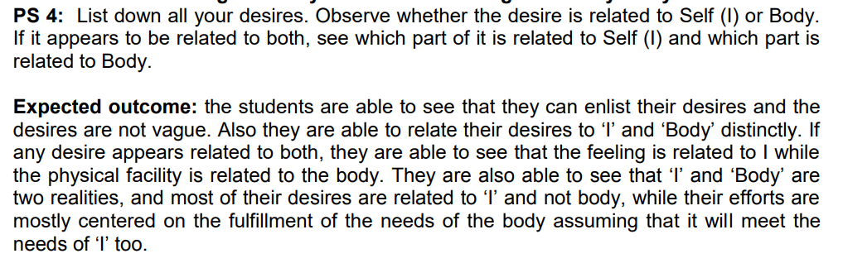
SESSION: 24 Practice Session-2

Slide 32
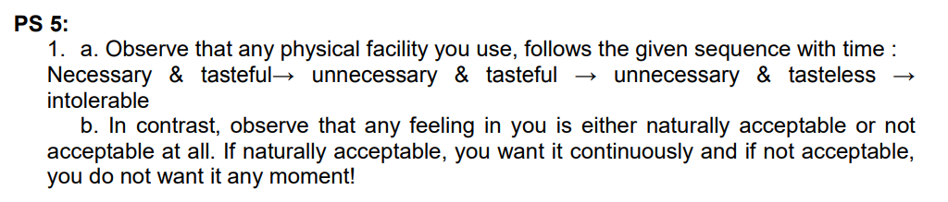
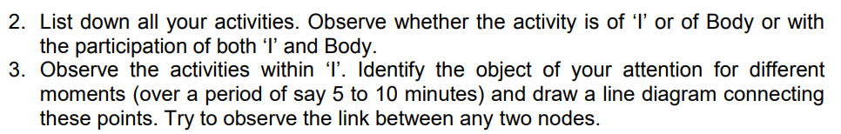
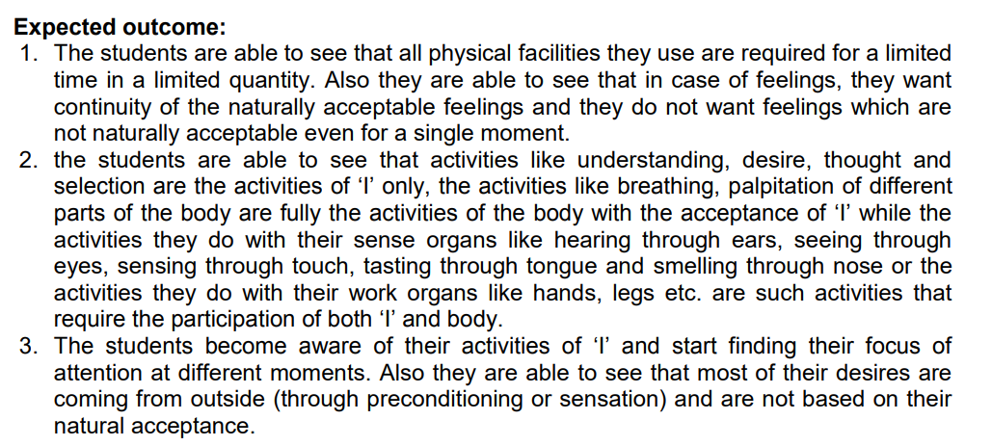
Practice Session-2

Slide 33
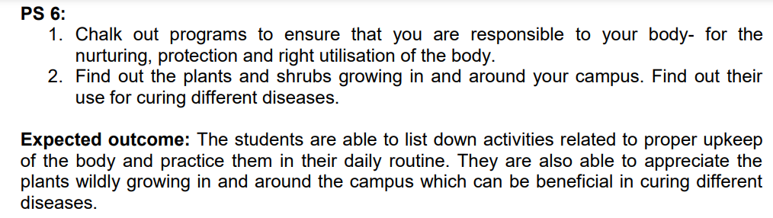
Practice Session-2

Slide 34
Important Questions
What are the source of preconditioning? (L1)
Define ‘Power’ and ‘Activity’ of self? (L1)
How can we ensure harmony in self (‘I’)? (L1)
Discuss the needs of the self are qualitative. (L2)
Differentiate the needs of the Self with the needs of the Body. (L2)
Describe the statement ‘Human being is co-existence of the Self and the Body. (L2)
Explain the activities of knowing, assuming, recognizing and fulfillment with one examples. (L2)
Explain how pre conditioning can lead to unhappiness. (L2)
Discuss how sensation from the body cannot be a source for continuous happiness. (L2)
Illustrate “The state of harmony or lack of it in the self has a strong influence on the health of the body” with an example. (L3)

Slide 35



138

